Slide 1
Chapter 2 X-1
Geometric Image Transform Spatial Transform

Slide 2
2.x.1 Fundamentals
2.x.1.1 Spatial Transform
Input image: f(u,v)
Output image: g(x,y)
g(x,y) = f(u,v)
(x,y) = T[(u,v)], 2013/9/16

Slide 3
2.x.1 Fundamentals
2.x.1.2 Forward Mapping
(x,y) = ( X(u,v),Y(u,v))
example: Zoom out
(x,y) = (u/2,v/2)
[Programming]

Slide 4
2.x.1 Fundamentals
2.x.1.3 Inverse Mapping
(u,v) = (U(x,y),V(x,y))
example: Zoom out
(u,v) = (x*2,y*2)
[Programming]

Slide 5
2.x.1 Fundamentals
example: Zoom in
FM: (x,y) = (u*2,v*2)
IM : (u,v) = (x/2,y/2)
[Programming]

Slide 6
2.x.1 Fundamentals
Usually
Image Processing(Spatial Transform) using IM
Computer Graphics (Geometrics Render) using FM

Slide 7
2.x.2 Affine Transform
2.x.2.1 Definition of Affine Transform
A(x) = L(x) + c
2.x.2.2 General Form

Slide 8
2.x.2 Affine Transform

Slide 9
2.x.2 Affine Transform
2.x.2.3 Others Exercise
Flip Transform
Flip Horizontal
Flip Vertical
Zoom At (x0,y0)
Local Zooming
[Programming]

Slide 10


Exercise
FlipV

Slide 11

Exercise
FlipH

Slide 12
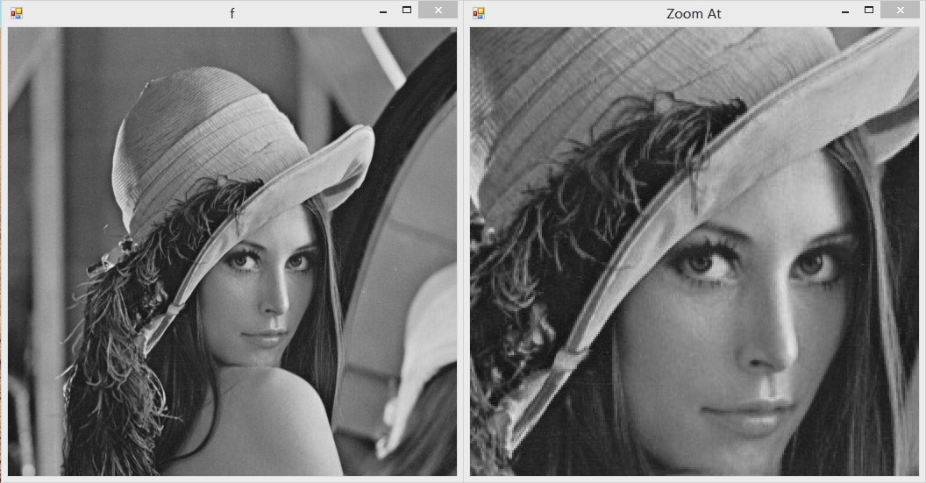
Exercise （2014.9.22）
Byte[,] ZoomAt(byte[,]f,int x0,int y0,float K)

Slide 13

Exercise
byte[,] localZooming(byte[,]f,int x0,int y0,float R,float K)

Slide 14
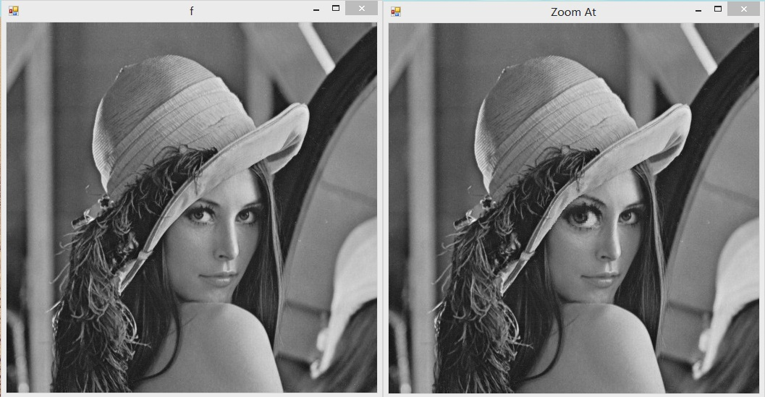
Exercise
byte[,] localZooming2(byte[,]f,int x0,int y0,float R,float K)

Slide 15
Composted Affine Transform
Basic Affine Transform
Translation, Scaling, Rotation
Composted Affine Transform
eg. Zooming At

Slide 16
Affine Transform Properties
Composted Affine Transform is Affine Transform
Inverse Affine Transform is Affine Transform

Slide 17
2.x.3 Image Interpolation
2.x.3.1 Background
[Programming of Zoom in 4X4]

Slide 18
2.x.3 Image Interpolation
2.x.3.2 Sampling & Interpolation
Sampling
f(X)
f[n]
Interpolation
f[n]

Slide 19
2.x.3 Image Interpolation
2.x.3.2 Sampling & Interpolation
f[n] = f(n) , f[n] = int(f(n))
h(x):Interpolation Kernal

Slide 20
2.x.3 Image Interpolation
2.x.3.2 Nearest Neighborhood Interpolation
2D: x’=(int)(x+0.5),y’=(int)(y+0.5)

Slide 21
2.x.3 Image Interpolation
2.x.3.2 Bilinear Interpolation
i<=x<i+1
a = x-i
f(x)=f[i] *(1-a)+f[i+1]*a;

Slide 22
2.x.3 Image Interpolation
2.x.3.2 Bilinear Interpolation
2D
i<=x<i+1,j<=y<j+1,
a = x-i, b = y-j
f(x,j) = f[i,j]*(1-a)+f[i+1,j]*a;
f(x,j+1) = f[i,j+1]*(1-a)+f[i+1,j+1]*a;
f(x,y) = f(x,j)*(1-b)+f(x,j+1)*b;
[Programming]

Slide 23
2.x.3 Image Interpolation

Slide 24
Image Registration

